Slide 1

Confluent Interview
David Herst 1/9/2025

Slide 2
Agenda
Who am I?
The TMM role
What I’ve learned so far
The technical exercise
My road forward

Slide 3
Who am I?
Experienced technical interpreter
Made complex tech subjects accessible through writing, teaching, presentation
Regularly learned a new tech quickly in order to create and teach a course
Seasoned customer-facing advocate
Long experience in customer-facing roles, both commercial and government
Architectural (big picture) thinker
Broad, long IT experience

Slide 4
What does the Flink TMM role call for?
Goal: Showcase Flink in Confluent Cloud as a critical business solution
High level activities
Make the strong business case for Flink to tech (and non-tech) audiences
Convey that case through a catalog of marketing collateral and activities
Flink’s core value:
R/t stateful stream-based analytics
Dynamic, adaptable analysis
High level use cases for Flink
Detecting emergent bad behavior (e.g. bank fraud)
Detecting emergent good behavior (e.g. opportunities for optimization)
Sharing insights from one unit to the entire enterprise

Slide 5
What does the Flink TMM role call for?
Responsibilities
Create collateral: workshops, webinars, blogs, white papers, demo’s, hands-on events
Evangelize Flink’s value in common use cases and with best practices
Coordinate with marketing teams on how best to promote Flink
Liaise between customer teams and product team re issues and desired features
Comparatively analyze Flink’s competition
Audiences
Internal: account teams, SMEs
External: customers, user groups, community, technical events

Slide 6
What I’ve learned so far
Kafka and streaming:
Key business advantages over traditional DBMS/ETL paradigm
Key concepts and mechanics
Flink:
Stream processing: enrich, join, split, filter
Stateful processing: aggregations, multi-message analysis
Confluent Cloud: advantages over OSS Kafka
Training
Kafka 101
Kafka Streams 101
ksqlDB tutorial
Flink 101

Slide 7
The Technical Exercise
Two major pieces:
Pull Kaggle movie data into Confluent Cloud
Use Flink to analyze movie data, answering certain questions

Slide 8
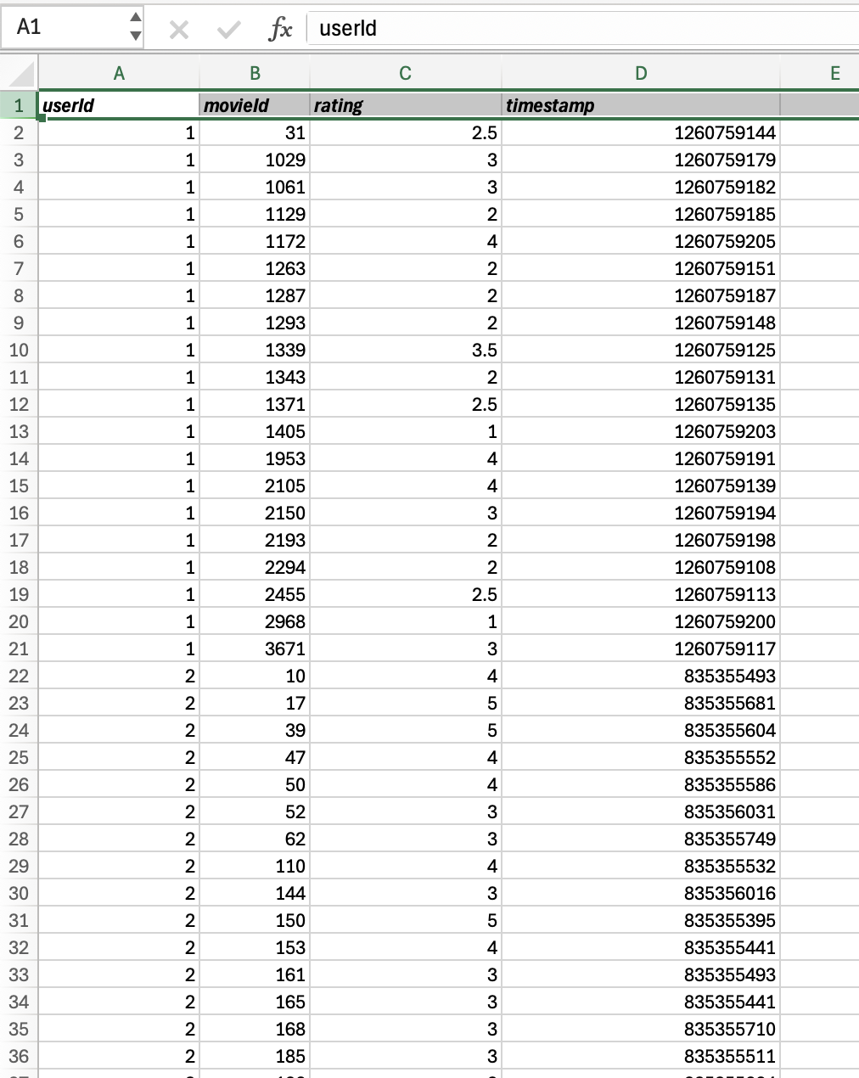
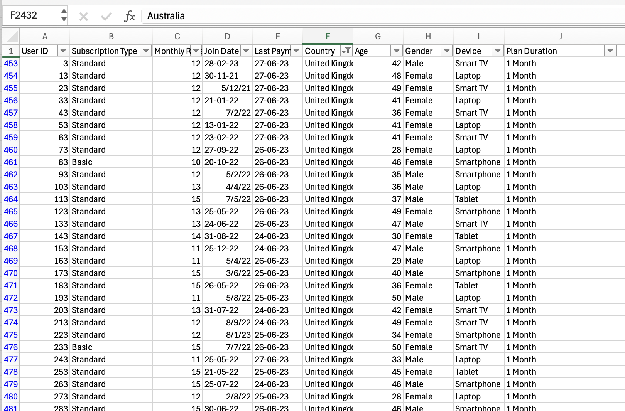
The Technical Exercise: Kaggle Data

Slide 9
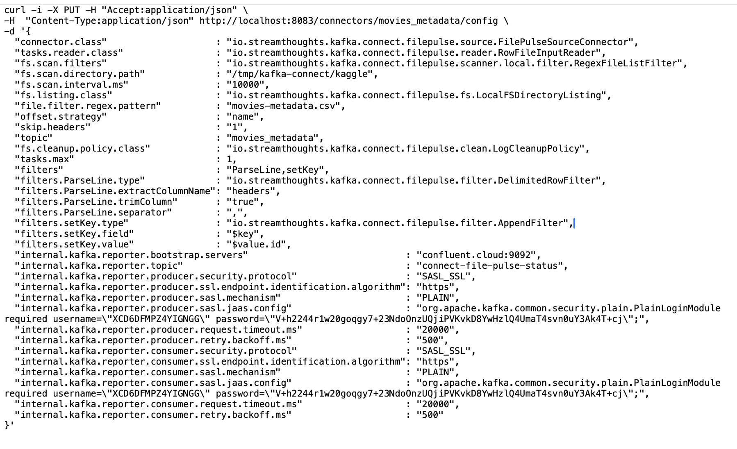
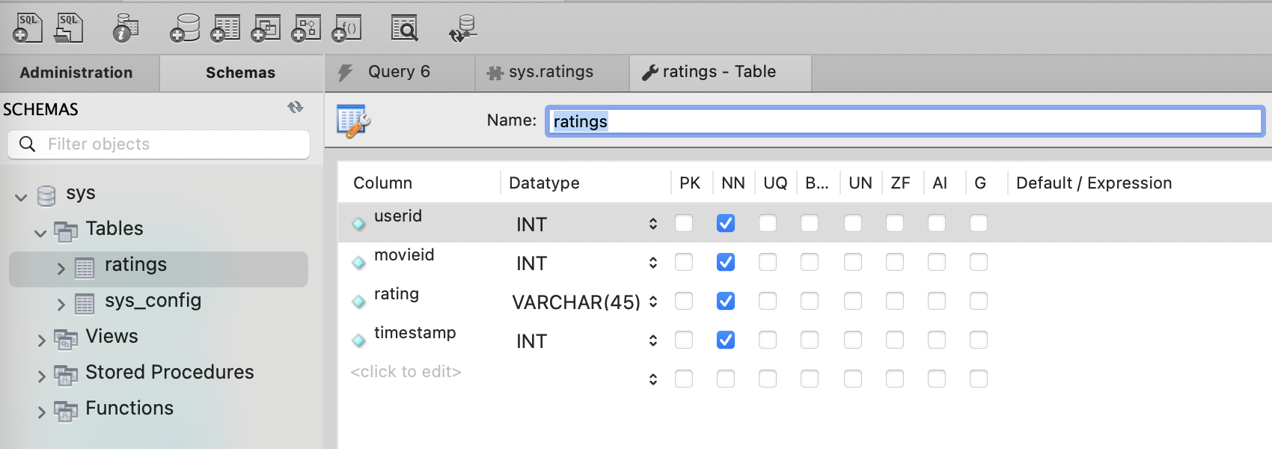
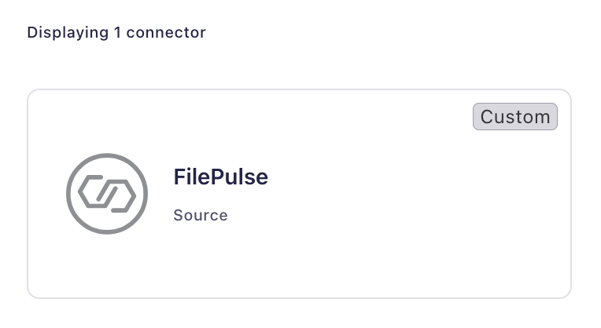
The Technical Exercise: Kaggle Data
I downloaded the Kaggle data into CSVs
I tried several ways to pull the CSVs into Confluent Cloud, w/o success
FilePulse connector packaged as a plugin
FilePulse connector installed via REST API
Loading CSV data into MySQL

Slide 10
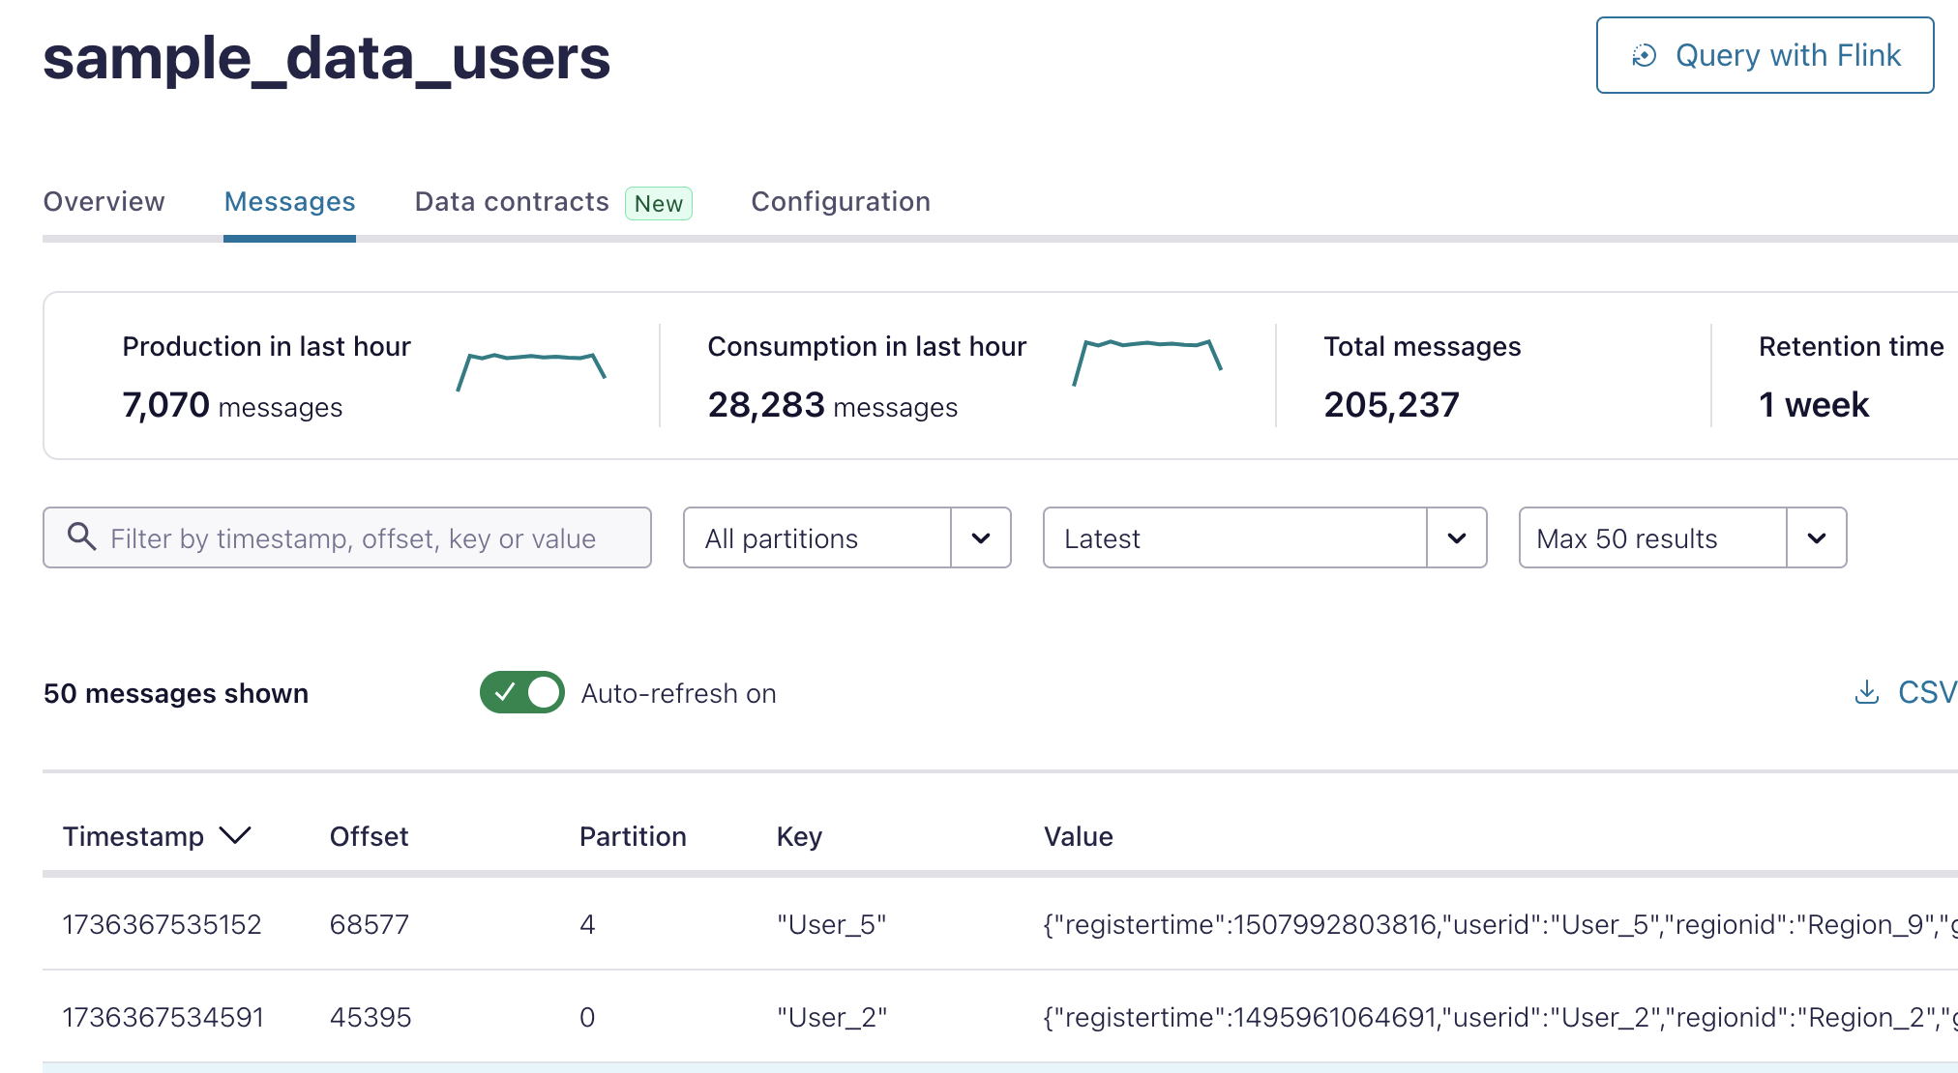
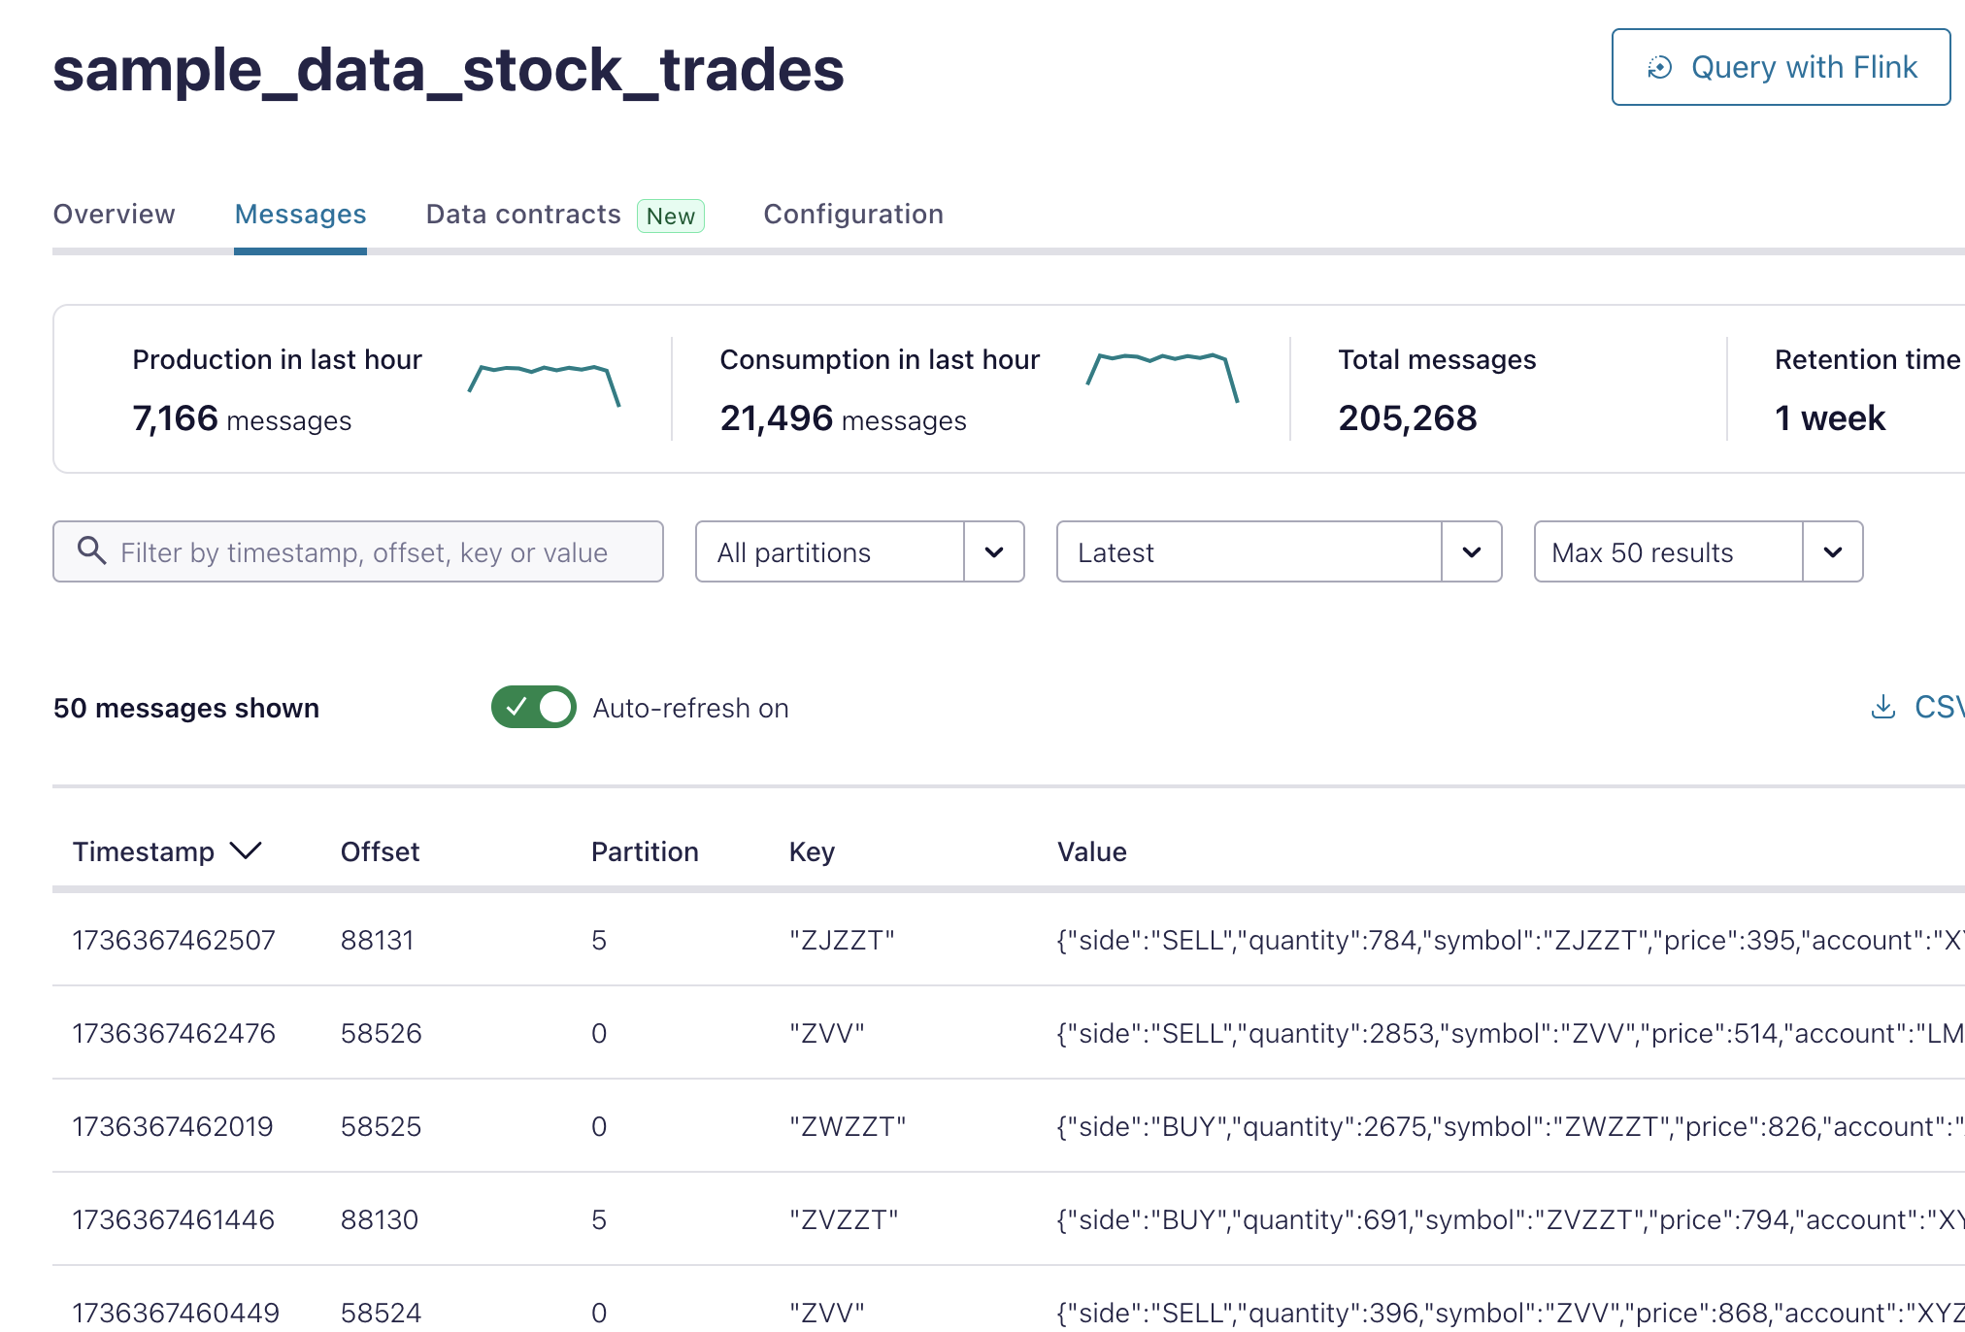
The Technical Exercise: Sample Data
To fulfill the spirit of the exercise, I used sample data in Confluent Cloud
users
stock trades
The two topics are joined by userid

Slide 11
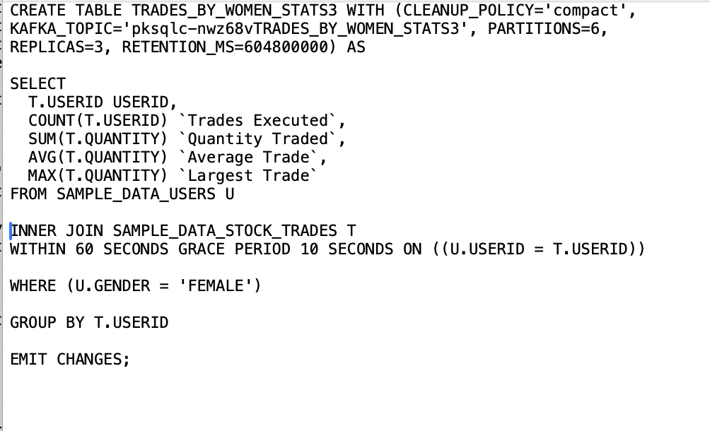
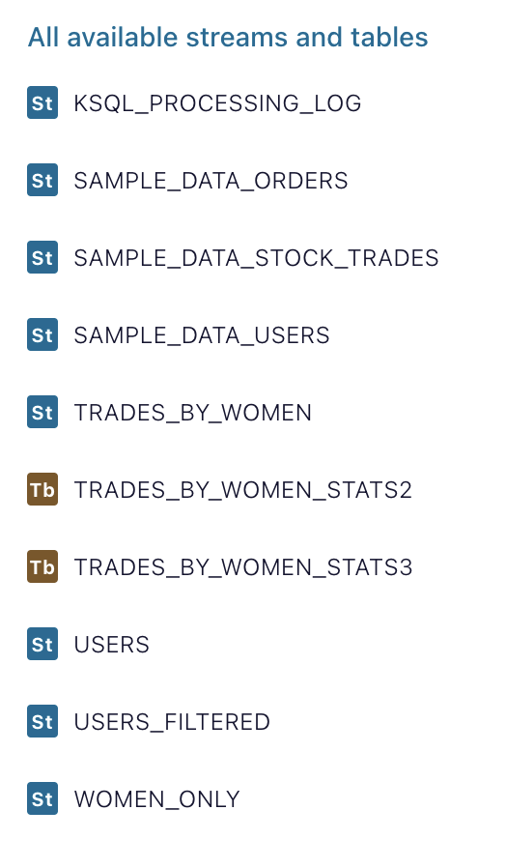
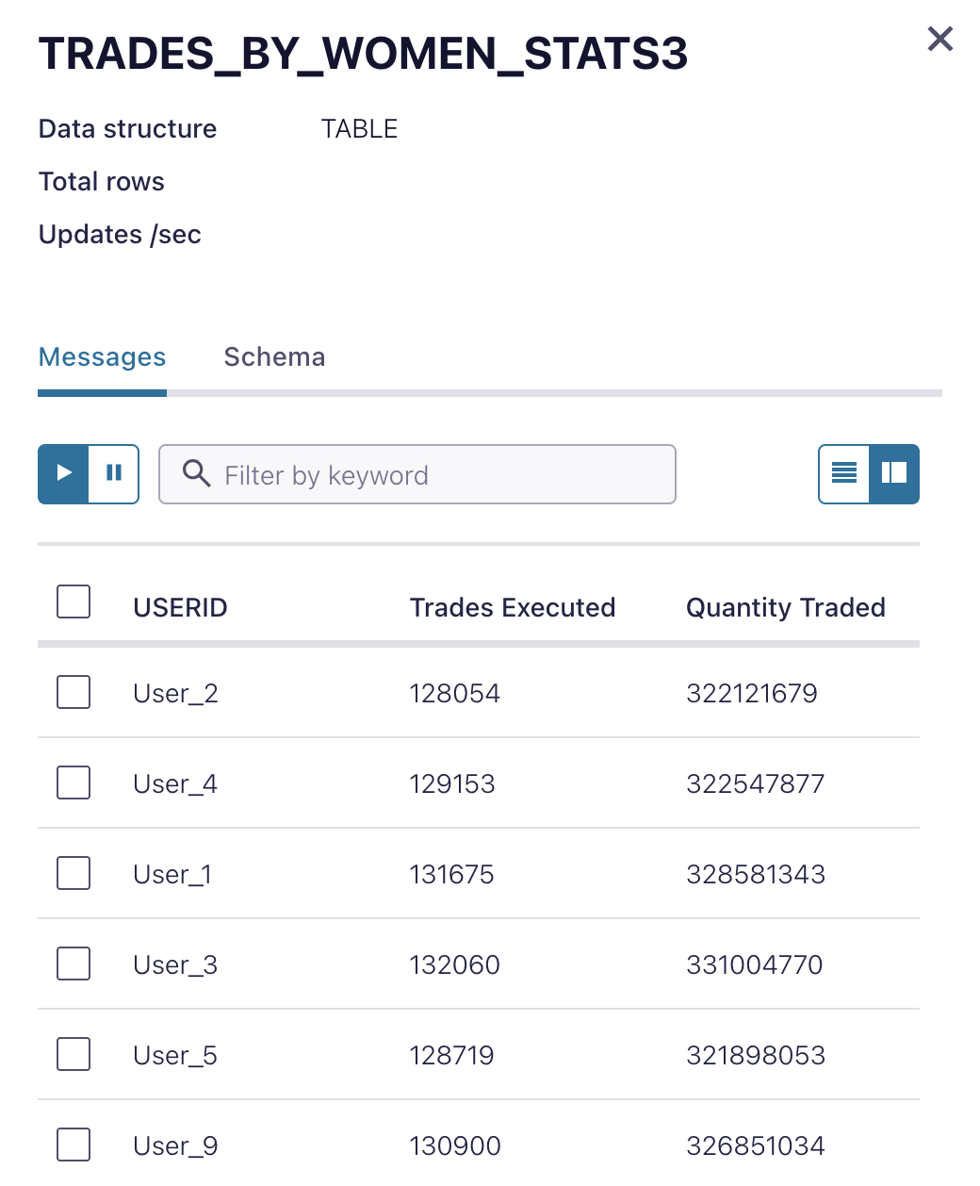
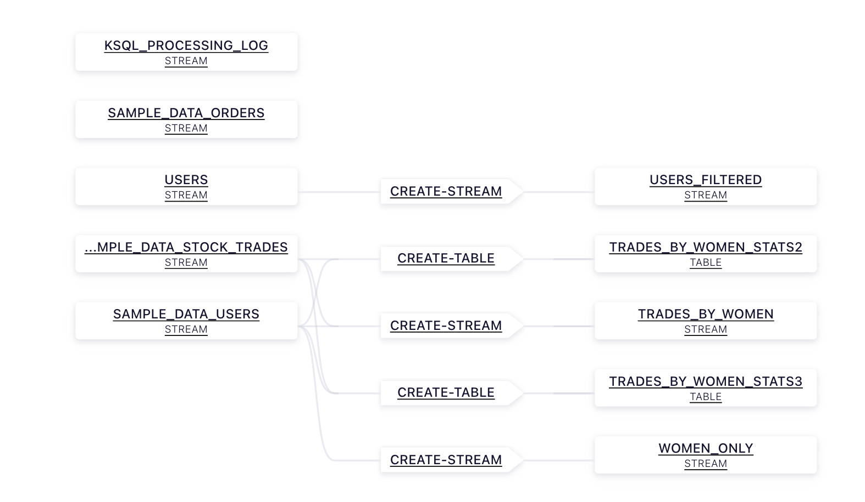
The Technical Exercise: ksql

Slide 12
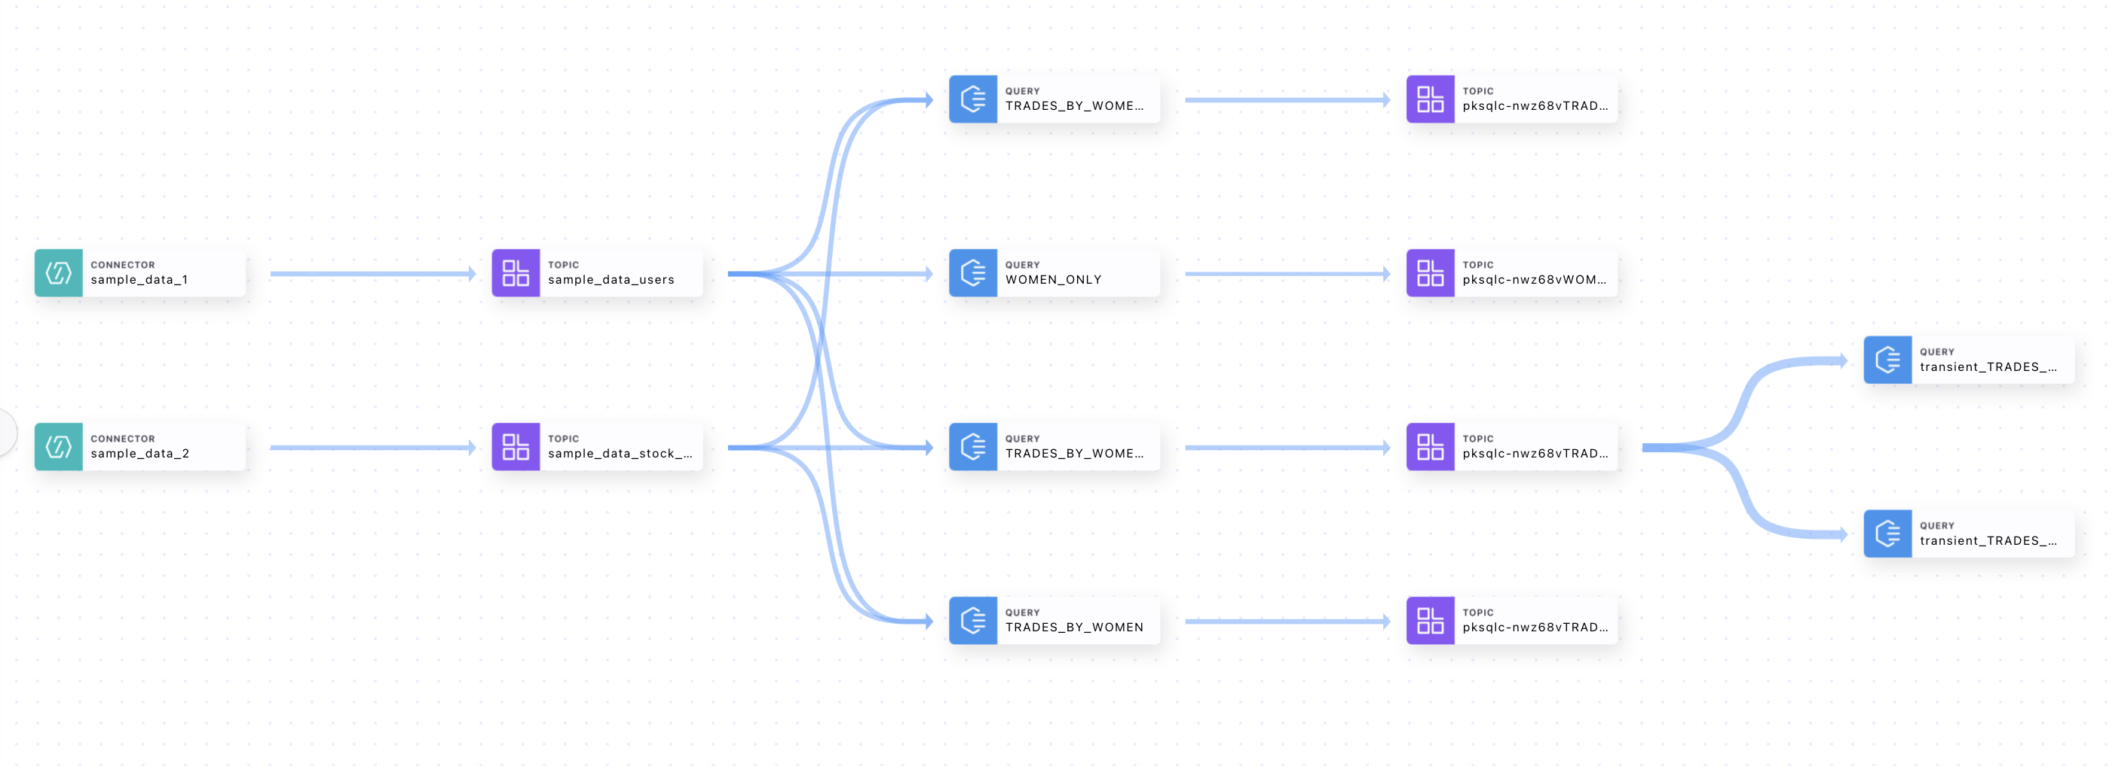
The Technical Exercise: Flink

Slide 13
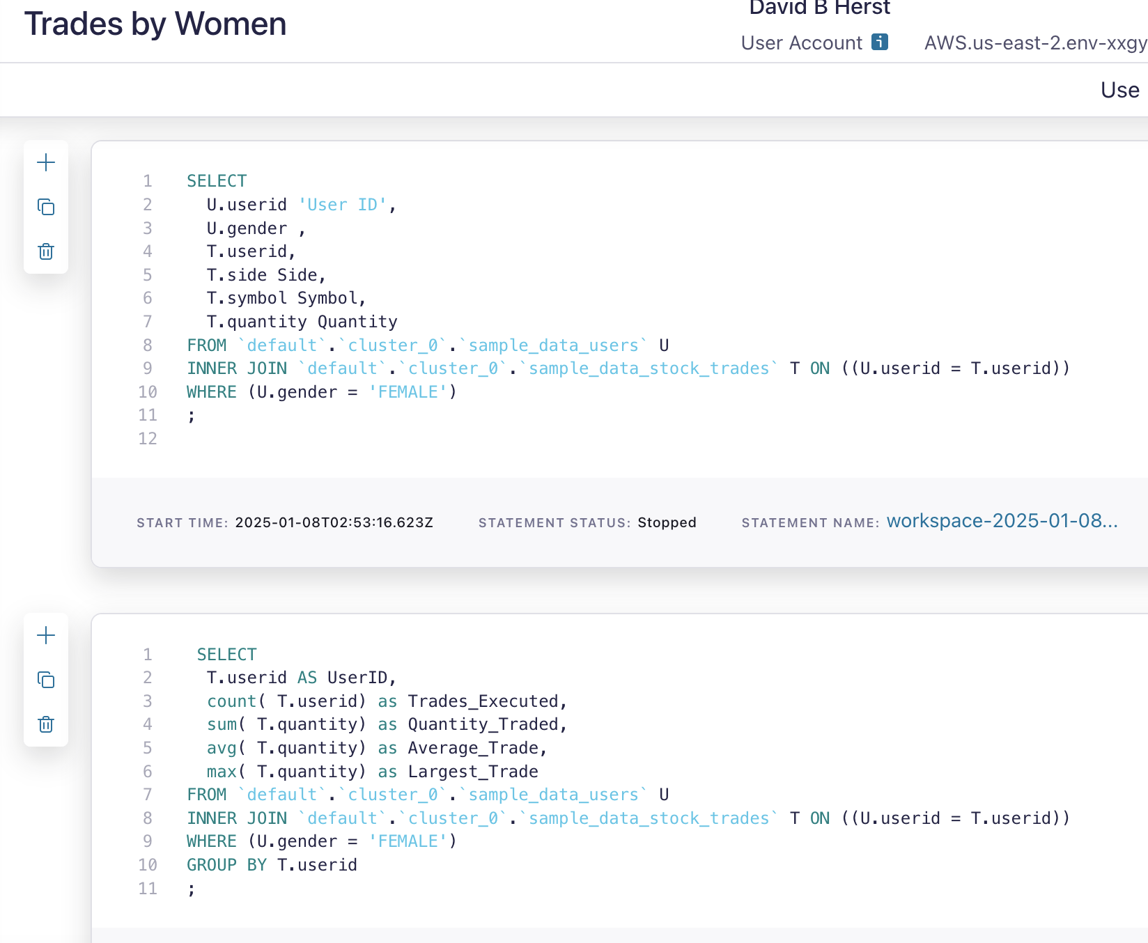
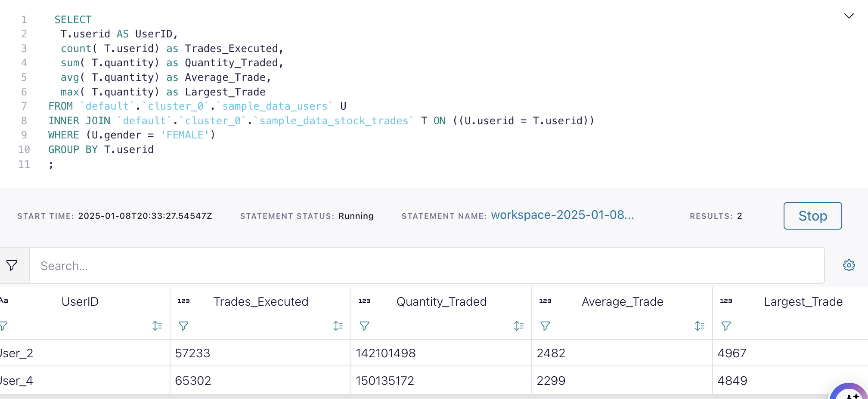
The Technical Exercise: Flink

Slide 14
My Road Forward
Intense deep dive into Confluent, Kafka, Flink
Take stock of current technical marketing landscape
Existing material on Flink
Programs in other areas
Connect with key resources at Confluent
Marketing team
Flink product team
Training team

Slide 15
THANK YOU

